Slide 1
Mixed Models, Model Fit, Repeated Measures
Ridgetown Grad Student Network
April 16, 2026

Slide 2
MIXED Model vs GLMM?
Mixed model (Linear)
  FIXED and RANDOM effects
  Gaussian or Normal distribution of the outcome variable
Generalized Linear Mixed Model
  FIXED and RANDOM effects
  Gaussian or Normal, and Non-Gaussian distribution of the outcome variable

Slide 3
MIXED Model vs GLMM?
Linear Mixed model is a type of GLMM
In SAS – Proc GLIMMIX works for most models we have today
In R – there are different packages for different types of distributions
  LME4 – has many of the distributions we use
  glmmTMB

Slide 4
Statistical Model
Is a way to describe the variation in the outcome measure
Always tied to your research question AND your experimental design
Once you have your statistical model:
  Identify the FIXED and RANDOM effects
  ”Translate” into SAS, R, or any statistical package you are using

Slide 5
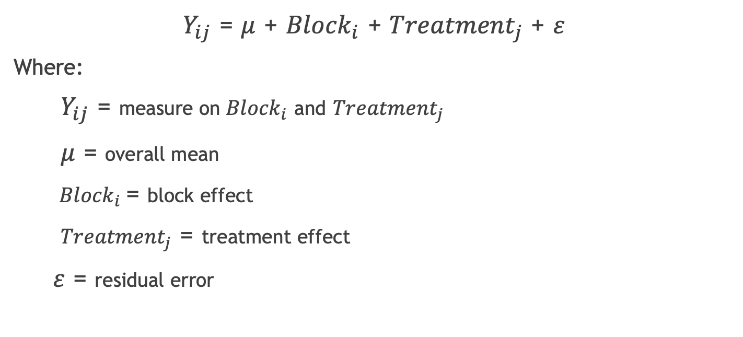
Statistical Model
$Y_{ij}$ = $μ$ + ${Block}_{i}$ + ${Treatment}_{j}$ + $ε$
Where:
$Y_{ij}$ = measure on ${Block}_{i}$ and ${Treatment}_{j}$
$μ$ = overall mean
${Block}_{i}$= block effect
${Treatment}_{j}$ = treatment effect
$ε$ = residual error
Fixed
Random
Fixed
Random

Slide 6
How to build your statistical model
Know your experimental design and matching model
Use someone else’s
Guess??
Let’s work through a couple of examples

Slide 7
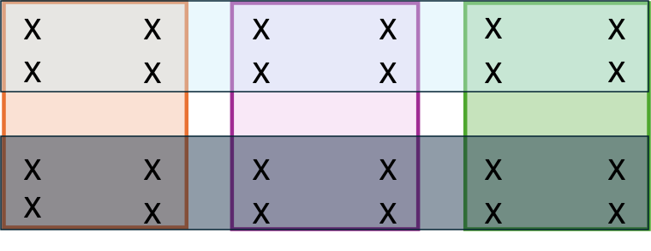
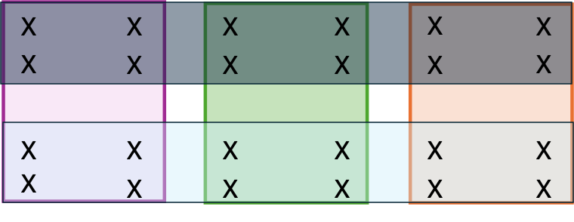



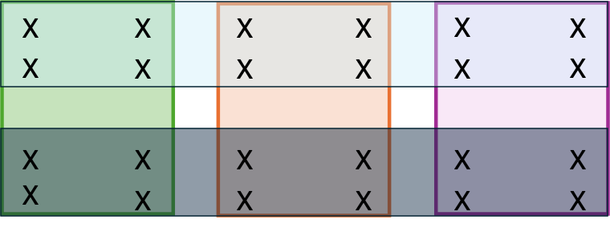


Field trial
9 plots (3 blocks with 3 plots in each block)
3 crops
2 N treatments
8 measures of plant height taken on 1 day
in each plot
101
102
103
Block 1
Crop1: Corn
201
202
203
Block 2
Crop2: Rye
Crop3: Soybean
N1 treatment
N2 treatment
301
302
303
Block 3
X
Outcome measure

Slide 8
What are the experimental units?
Crops??
N Treatment??
Crop x N Treatment??
What about the X’s??

Slide 9
Work out our statistical model
Crops: Block + Crop + Block x crop
N Treatment: Block + Ntreatment + Block x Ntreatment
Crop x N treatment: Crop x Ntreatment + Block x Crop x Ntreatment

Slide 10
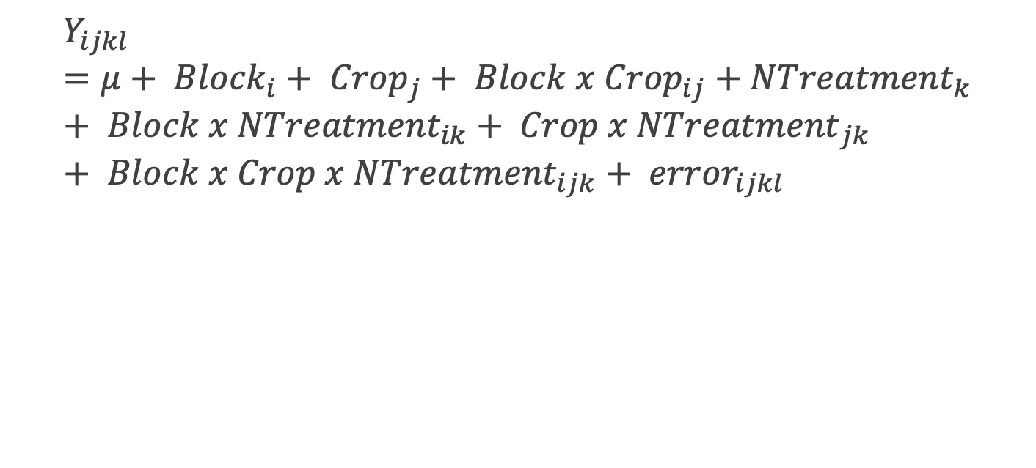
Work out our statistical model
$$Y_{ijkl}=μ+ {Block}_{i}+ {Crop}_{j}+ {Block x Crop}_{ij}+{NTreatment}_{k}+ {Block x NTreatment}_{ik}+ {Crop x NTreatment}_{jk}+ {Block x Crop x NTreatment}_{ijk}+ {error}_{ijkl}$$

Slide 11
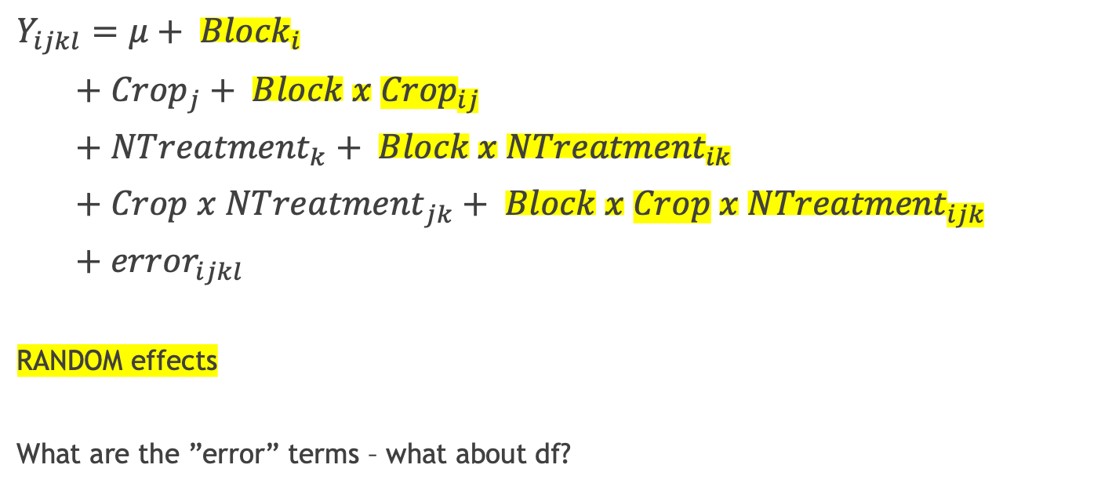
Work out our statistical model
Df calculations
3 blocks = 2
3 crops = 2
Block x crop = 4
2 N treatments = 1
Block x Ntrmt = 2
Crop x Ntrmt = 2
Block x crop x Ntrmt = 4
Residual error =
72-1-2-2-4-1-2-2-4 =
54
$$Y_{ijkl}=μ+ {Block}_{i}$$
$+ {Crop}_{j}+ {Block x Crop}_{ij}$
$+ {NTreatment}_{k}+ {Block x NTreatment}_{ik}$
$+ {Crop x NTreatment}_{jk}+ {Block x Crop x NTreatment}_{ijk}$
$+ {error}_{ijkl}$
RANDOM effects
What are the ”error” terms – what about df?

Slide 12
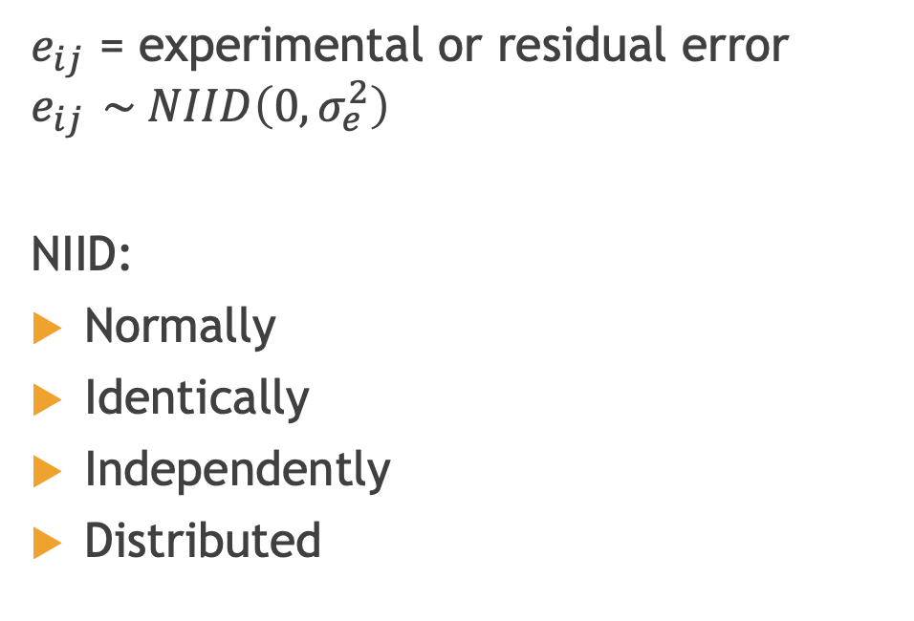
How do we check for Model fit?
What are the assumptions again???
$e_{ij}$ = experimental or residual error
$$e_{ij } \sim NIID\left(0,σ_{e}^{2}\right)$$
NIID:
Normally
Identically
Independently
Distributed
Random
Independent of treatment and design
Common covariance (homogenous)
Normally distributed
Mean and Sum of 0

Slide 13
How do we check for Model fit?
Residuals
NOT
Raw Data

Slide 14
Now let’s add Repeated Measures
Is our statistical model the same?
What changes / what is added?
Time effect
What else do we need to change?

Slide 15
Model fit
Check the same things!!!
Any changes?
Challenges??

Slide 16
Try on your own – two different combinations of a field trial
I’ll add my coding to a separate blog post

Slide 17
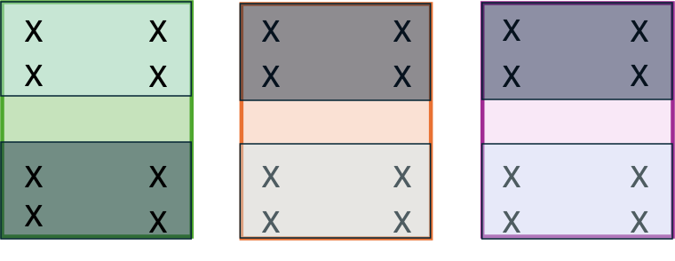
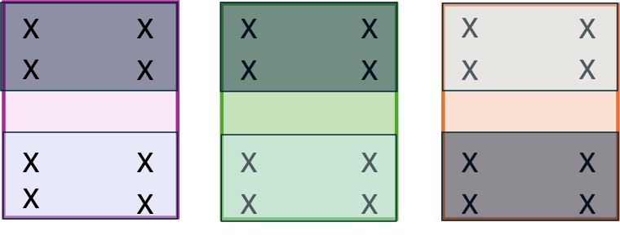
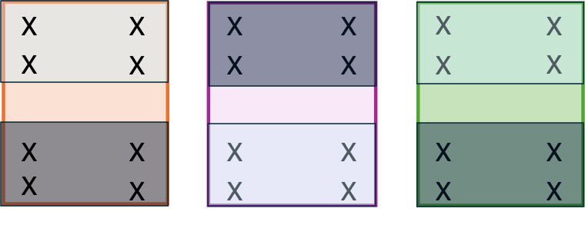
Field Trial #2
101
102
103
Corn
Rye
Soybean
N1 treatment
201
202
203
N2 treatment
X
Outcome measure
301
302
303

Slide 18
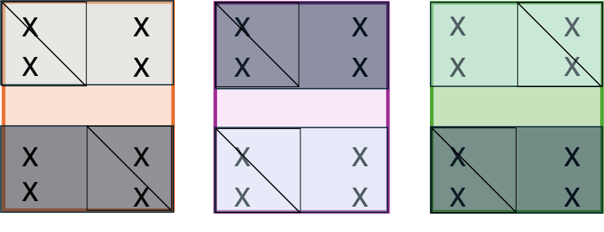
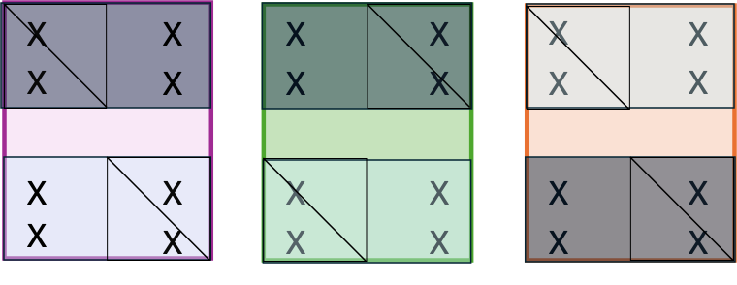
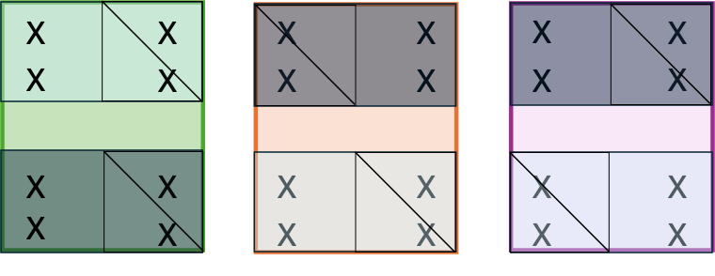
Field Trial #3
101
102
103
Tillage
No tillage
Corn
Rye
201
202
203
Soybean
N1 treatment
N2 treatment
X
Outcome measure
301
302
303

